Slide 1
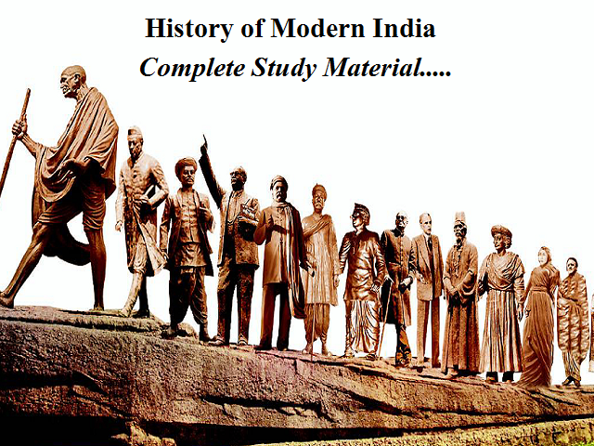
Module: 6 Modern India

Slide 2
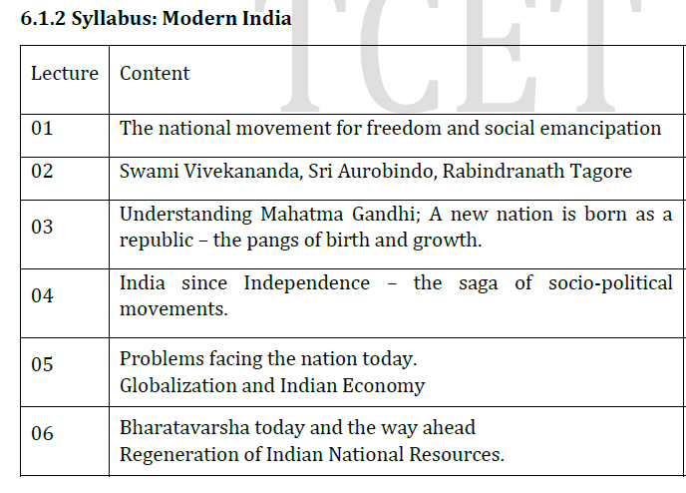
Content:

Slide 3
Introduction
Modern India has experienced remarkable economic growth and development in recent decades, emerging as a global economic powerhouse.
Modern India encompasses the period of India's history from the mid-18th century to the present day, characterized by transformative changes, struggles for independence, socio-political movements, economic developments, and cultural advancements.
There are several compelling motivations behind the study of modern India, which shed light on its rich heritage, complexities, challenges, and contributions to the global stage.

Slide 4
Introduction
India's history is a tapestry of various dynasties, empires, and civilizations, each leaving a unique imprint on its cultural fabric. By studying modern India, we gain insights into the traditions, art forms, languages, and customs that have evolved and persisted through centuries. This knowledge helps preserve and celebrate India's diverse cultural legacy, fostering pride and identity among its people.
Modern India witnessed significant social and political transformations that shaped its current socio-economic and political landscape. The struggle for independence against British colonial rule, led by iconic leaders like Mahatma Gandhi and Jawaharlal Nehru, reflects a journey of resilience and determination. The study of these movements provides invaluable lessons in civil disobedience, nonviolence, and the pursuit of social justice, inspiring individuals and nations worldwide.

Slide 5
Key events and developments in modern India include:
British Colonial Rule
Indian Independence Movement
Partition of India
Social Changes
Economic Reforms
Adoption of the Constitution
Political Landscape
Technological Advancements
Challenges and Opportunities
Cultural Diversity

Slide 6
The national movement for freedom and social liberation
Key aspects of such a movement may include
Freedom and Liberation: The movement seeks to liberate the people from various forms of oppression, whether it be colonial rule, dictatorship regimes, or discriminatory practices based on race, gender, religion, or other factors.
Social Justice and Equality: The movement aims to address social inequalities and advocate for equal rights, opportunities, and treatment for all members of society. It seeks to challenge and dismantle systemic discrimination and promote inclusivity.
Liberation from Economic Exploitation: The movement often highlights the need to improve the economic conditions of the marginalized and oppressed groups, seeking fair wages, labor rights, and an end to economic exploitation.

Slide 7
Nonviolent Resistance and Civil Disobedience: Many national movements for freedom and social liberation adopt nonviolent resistance and civil disobedience as strategies to effect change, inspired by leaders like Mahatma Gandhi and Martin Luther King Jr.
Unity and Solidarity: These movements often emphasize the strength of unity and solidarity among diverse groups and individuals who share common goals of freedom and social justice.
Advocacy and Political Engagement: Advocacy plays a crucial role in these movements, as they seek to influence policymakers and demand changes in laws and policies that perpetuate oppression and inequality.

Slide 8
Examples of such movements include:
Civil Rights Movement in the United States
Indian Independence Movement
Women's Suffrage Movement
Labor Movements

Slide 9
Examples of such movements include
Civil Rights Movement in the United States: Fought for racial equality and an end to segregation and discrimination against African Americans.
Indian Independence Movement: Led by figures like Mahatma Gandhi, sought freedom from British colonial rule and social reforms in India.
Anti-Apartheid Movement in South Africa: Worked to end the racial segregation and oppressive policies of the apartheid regime.

Slide 10
Cont..
Women's Suffrage Movement: Fought for women's right to vote and gender equality.
Labor Movements: Various labor movements have advocated for workers rights, fair wages, and improved working conditions across the world.
These movements are often transformative and have a lasting impact on the societies in which they occur, paving the way for greater freedom, equality, and social justice

Slide 11
1. What does the national movement for freedom and social emancipation seek to achieve?
a) Economic exploitation
b) Social inequality
c) Systemic discrimination
d) Freedom from oppression and social justice e) All of the above
2. Which strategy is often adopted by these movements to effect change?
a) Violent resistance
b) Civil disobedience
c) Military intervention
d) Economic sanctions
3. Which of the following movements sought racial equality and an end to segregation and discrimination against African Americans?
a) Indian Independence Movement
b) Civil Rights Movement in the United States
c) Anti-Apartheid Movement in South Africa
d) Women's Suffrage Movement

Slide 12
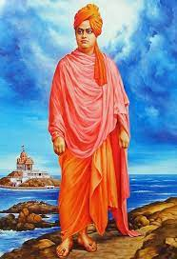
Swami Vivekananda, Sri Aurobindo, Rabindranath Tagore
Swami Vivekananda

Slide 13
Swami Vivekananda, Sri Aurobindo, Rabindranath Tagore
The contributions of various reformers:
Swami Vivekananda was a renowned Indian monk and a key figure in the introduction of Indian philosophies of Vedanta and Yoga to the Western world
Some of his major contributions include:
Revival of Hinduism
Advocacy of Universal Spirituality
Introduction of Yoga and Meditation
Promotion of Education
Youth Empowerment
Representation of India at the World's Parliament of Religions

Slide 14
1. Revival of Hinduism: Swami Vivekananda played a crucial role in revitalizing Hinduism during a period when it faced challenges from British colonial rule and Western influence. He presented the philosophical and spiritual aspects of Hinduism in a way that resonated with the modern youth and intellectuals.
2. Advocacy of Universal Spirituality: Vivekananda's message of universal spirituality transcended religious boundaries. He emphasized the idea of the underlying unity of all religions and highlighted the importance of tolerance and respect for different faiths.
3. Introduction of Yoga and Meditation: Swami Vivekananda popularized the practice of yoga and meditation both in India and abroad. His teachings on Raja Yoga and the significance of meditation for personal growth and self-realization have had a profound impact on modern spiritual practices

Slide 15
Promotion of Education: Vivekananda recognized the importance of education in shaping the future of India. He founded the Ramakrishna Mission, which established educational institutions, schools, and colleges to provide education to the masses, including the underprivileged.
Emphasis on Social Service: Swami Vivekananda believed in the concept of "Daridra Narayana Seva" (serving the poor as a form of serving God). He encouraged his followers to engage in selfless service and humanitarian activities to uplift the less fortunate.
Youth Empowerment: Vivekananda's message resonated strongly with the youth of India. He believed in harnessing the energy and potential of the youth for the nation's progress and transformation. He inspired young people to take pride in their culture and heritage while being open to new ideas and learning.

Slide 16
Representation of India at the World's Parliament of Religions: One of Vivekananda's most significant contributions was his speech at the World's Parliament of Religions held in Chicago in 1893. His address on "Sisters and Brothers of America" garnered widespread acclaim and introduced India's spiritual traditions to the West.
Emphasis on Character Building: Swami Vivekananda stressed the importance of character development and moral values. He believed that a strong character was the foundation of an individual's success and the nation's progress.
Inspiration for Nationalism: Vivekananda's ideas and teachings played a role in shaping India's nationalist movement. His call for a strong and united India instilled a sense of pride and patriotism among Indians.

Slide 17
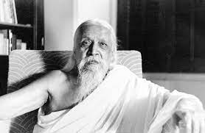
Sri Aurobindo

Slide 18
Sri Aurobindo
Sri Aurobindo was a prominent philosopher, poet, yogi, and nationalist leader who made significant contributions to modern India. His ideas and teachings have had a profound impact on various spheres, including spirituality, education, literature, and the nationalist movement. Some of Sri Aurobindo's major contributions are as follows:
Integral Yoga and Spirituality
Pondicherry Ashram
The Mother
Synthesis of Eastern and Western Thought
Evolutionary Vision

Slide 19
Integral Yoga and Spirituality: Sri Aurobindo developed the concept of Integral Yoga, a path of spiritual evolution that seeks to harmonize and integrate all aspects of human existence, including the physical, mental, and spiritual dimensions. His spiritual teachings have inspired countless individuals in their quest for self-realization and inner transformation.
The Mother (Mirra Alfassa): Sri Aurobindo's spiritual collaborator, known as "The Mother," played a significant role in the growth and development of the Sri Aurobindo Ashram. Her influence and guidance have been instrumental in spreading the teachings of Integral Yoga.
Contributions to Literature: Besides his spiritual writings, Sri Aurobindo was a prolific poet, playwright, and literary critic. His literary works, which include epic poems like "Savitri," are considered significant contributions to Indian literature.
Nationalist Movement: In his early years, Sri Aurobindo was actively involved in India's freedom struggle against British colonial rule. He was a leader of the revolutionary movement in Bengal and editor of the nationalist newspaper "Bande Mataram." However, after his spiritual transformation, he withdrew from active politics and focused on his spiritual mission.

Slide 20
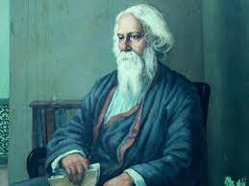
Rabindranath Tagore

Slide 21
Rabindranath Tagore
Rabindranath Tagore, often referred to as Gurudev, was a polymath, poet, philosopher, musician, and artist who made immense contributions to modern India. His influence extended beyond literature and arts, impacting various facets of Indian society. Some of Rabindranath Tagore's major contributions are as follows:
Literature and Poetry
National Anthem of India
Nationalism and Patriotism
Visva-Bharati University
Social and Educational Reforms

Slide 22
National Anthem of India: Tagore's composition "Jana Gana Mana" was adopted as the national anthem of India in 1950. The song, originally written in Bengali, embodies the idea of national unity and inclusivity.
Nationalism and Patriotism: Through his literary works and speeches, Tagore played a significant role in shaping the intellectual discourse on nationalism in India. While he initially supported the Swadeshi movement, he later became critical of narrow nationalism and emphasized the importance of a universal humanistic outlook.
Visva-Bharati University: In 1921, Tagore founded Visva-Bharati University in Santiniketan, West Bengal. It was an experiment in alternative education that combined the best of Indian and Western educational principles, fostering an atmosphere of creativity, inclusivity, and freedom of thought

Slide 23
International Cultural Exchange: Tagore's travels abroad and interactions with prominent figures like Albert Einstein, Ezra Pound, and Thomas Mann helped foster cultural exchange between India and the rest of the world. He used his international recognition to promote understanding and appreciation of Indian culture.
Environmental Awareness: Tagore's writings also reflected a deep concern for the environment. His nature-centric poems and essays emphasized the need for harmony between human beings and nature.

Slide 24
What was Rabindranath Tagore's major literary achievement that earned him the Nobel Prize in Literature in 1913?
a) Composing thousands of poems and essays
b) Founding Visva-Bharati University
c) Writing the national anthem of India
d) Composing the song "Jana Gana Mana"
Who was Sri Aurobindo's spiritual collaborator and played a significant role in the growth of the Sri Aurobindo Ashram?
a) Rani Lakshmibai
b) Sarojini Naidu
c) The Mother (Mirra Alfassa)
d) Annie Besant
Vivekananda founded the Ramakrishna Mission to establish ____________ to provide education to the masses, including the underprivileged.
a) Hospitals
b) Temples
c) Educational institutions
d) Orphanages

Slide 25
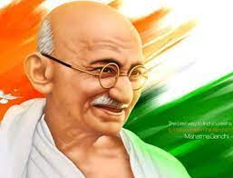
Mahatma Gandhi

Slide 26
Understanding Mahatma Gandhi; A new nation is born as a republic – the pangs of birth and growth
Mahatma Gandhi's Role in India's Struggle for Independence: Mahatma Gandhi, also known as the Father of the Nation (Bapu), was the foremost leader of India's nonviolent struggle for independence from British colonial rule. He adopted the principles of truth (Satya), nonviolence (Ahimsa), and civil disobedience to challenge British authority and inspire millions of Indians to join the freedom movement.
Gandhi's approach to nonviolent resistance, also known as Satyagraha, played a crucial role in uniting people from diverse backgrounds in the fight for independence. Through various campaigns such as the Non-Cooperation Movement, the Salt March, and the Quit India Movement, he mobilized the masses and brought attention to the injustices of colonial rule.

Slide 27
Challenges faced includes;
Partition and Communal Violence
Economic Struggles
Social Inequities
Consolidation of Diversity
Political Challenges

Slide 28
Partition and Communal Violence: The partition of India into India and Pakistan led to one of the largest human migrations in history, resulting in communal violence and the loss of countless lives and properties.
Economic Struggles: India inherited a weak and underdeveloped economy from colonial rule. Building a self-reliant and prosperous nation required significant efforts and economic reforms.
Social Inequities: The country continued to grapple with social issues such as poverty, illiteracy, caste discrimination, and gender inequality.
Consolidation of Diversity: India is known for its diverse cultural, linguistic, and religious identities. Building a unified nation while respecting and celebrating this diversity was a delicate and ongoing task.
Political Challenges: The newly independent nation faced the challenge of establishing a democratic governance system, drafting a constitution, and maintaining political stability.

Slide 29
What principles did Mahatma Gandhi adopt in India's struggle for independence?
a) Democracy and secularism
b) Satya (truth), Ahimsa (nonviolence), and civil disobedience
c) Communism and socialism
d) Capitalism and industrialization
2. What was the significance of Mahatma Gandhi's approach to nonviolent resistance?
a) It emphasized the use of military force to fight against colonial rule.
b) It united people from diverse backgrounds in the freedom movement.
c) It promoted the idea of British colonial rule as beneficial for India.
d) It advocated for religious conflicts to achieve independence.
3. When did India gain independence from British rule and become a republic?
a) August 15, 1945
b) August 15, 1947
c) August 15, 1950
d) August 15, 1960

Slide 30
India since Independence – the saga of socio-political movements
Indian Independence Movement (1857-1947): The struggle for India's independence from British colonial rule was a long and arduous process, marked by several non-violent and violent movements. Leaders like Mahatma Gandhi, Jawaharlal Nehru, Subhas Chandra Bose, and others played pivotal roles in mobilizing the masses to fight for freedom.
Dalit Movement: The Dalit movement, also known as the untouchable or Scheduled Caste movement, sought to end the discrimination and oppression faced by the lower castes. Leaders like B.R. Ambedkar led the movement and played a crucial role in drafting the Indian Constitution, which provided significant safeguards and reservations for Scheduled Castes.

Slide 31
Women's Movement: The women's movement in India emerged to address issues related to gender equality, women's rights, and social reform. It sought to challenge the patriarchy prevalent in society and promote gender justice. The movement gained momentum during and after independence, with prominent figures like Rani Lakshmibai, Sarojini Naidu, and later, Kamala Nehru and Indira Gandhi, advocating for women's empowerment.
Environmental Movements: India witnessed various environmental movements that aimed to protect its natural resources and wildlife. The Chipko Movement, Narmada Bachao Andolan, and Silent Valley Movement are some notable examples of efforts to conserve forests and rivers.
Anti-Corruption Movement: In the 21st century, India witnessed a significant anti-corruption movement led by social activist Anna Hazare and later joined by Arvind Kejriwal. This movement sought the implementation of a strong anti-corruption law, leading to the formation of the Lokpal Bill.

Slide 32
Cont…
LGBT Rights Movement
Regional Movements
Anti-Emergency Movement
Right to Information (RTI) Movement

Slide 33
1. Which movement aimed at achieving social justice and equality for the lower castes in India?
a) Dalit Movement
b) Women's Movement
c) Land Reforms Movement
d) Environmental Movement
2. Who played a pivotal role in mobilizing the masses during the Indian Independence Movement?
a) B.R. Ambedkar
b) Jawaharlal Nehru
c) Subhas Chandra Bose
d) Mahatma Gandhi
3. Which movement sought to protect India's natural resources and wildlife?
a) Women's Movement
b) LGBT Rights Movement
c) Environmental Movement
d) Right to Information Movement

Slide 34
Problems facing the nation today, Globalization and Indian Economy
The nation, in its ever-evolving landscape, faces a myriad of complex challenges that demand immediate attention and innovative solutions. These problems are diverse, ranging from economic issues to social disparities, environmental concerns, political polarization, and technological advancements.
Economic Inequality
Climate Change and Environmental Degradation
Health Care Access and Quality
Technological Disruptions and Automation
Cybersecurity and Digital Privacy
Education Disparities and Quality

Slide 35
Cont…
Globalization and Indian Economy :
Globalization had a significant impact on the Indian economy in modern times. It refers to the increased interconnectedness and integration of economies, markets, and societies across the world. India has been a part of the globalization process since the early 1990s when the government initiated economic reforms to liberalize and open up the economy.
Trade and Investment
Information Technology and Services
Outsourcing and Offshoring
Integration into Global Supply Chains
Technology Transfer and Innovation

Slide 36
1) Which of the following issues is characterized by an increasing gap between the rich and poor, leading to social unrest and diminished opportunities for the less privileged?
a) Climate Change
b) Technological Disruptions
c) Economic Inequality
d) Aging Population
2) What is the primary cause of climate change and its impact on the planet?
a) Industrialization and deforestation, leading to a rise in global temperatures and extreme weather events.
b) Political polarization and divisive rhetoric, causing social unrest and fragmentation. c) Technological advancements, such as artificial intelligence and automation, displacing jobs.
d) Inadequate access to quality healthcare and rising healthcare costs.
3) Which approach can help reduce political polarization and promote more informed and engaged citizens?
a) Strengthening cybersecurity measures and implementing strict data protection laws.
b) Investing in education that emphasizes critical thinking and unbiased information.
c) Implementing universal basic income initiatives to support displaced workers.
d) Transitioning towards renewable energy sources to combat climate change.

Slide 37
Bharatavarsha today and the way ahead, Regeneration of Indian National Resources
Technology and Innovation: India's IT and services sector has been a key driver of growth. The way ahead involves leveraging technology and promoting innovation in various sectors, including manufacturing, healthcare, agriculture, and renewable energy, to drive sustainable development and global competitiveness.
Infrastructure Development: India faces significant infrastructural challenges, including transportation, energy, and urban development. The way ahead involves robust investment and policy initiatives to build modern and efficient infrastructure that can support economic growth and improve the quality of life for citizens.
Environmental Sustainability: As India grows economically, the need for environmental conservation and sustainable practices becomes more critical. The way ahead includes greater focus on renewable energy, waste management, afforestation, and measures to combat air and water pollution.

Slide 38
Governance and Corruption: Transparent and efficient governance is essential for India's progress. The way ahead includes continued efforts to combat corruption, strengthen institutions, and ensure the effective delivery of public services.
Digital Transformation: India has witnessed a significant digital revolution, especially with the widespread adoption of smartphones and internet services. The way ahead involves harnessing the potential of digital technology for e-governance, e-commerce, and digital literacy.

Slide 39
Regeneration of Indian National Resources
The regeneration of Indian national resources in modern India is a crucial aspect of sustainable development and responsible governance. It involves efforts to conserve, protect, and replenish natural resources to ensure their availability for future generations. Here are some key areas where regeneration of national resources is important:
Forestry and Wildlife Conservation
Water Resources Management
Renewable Energy
Soil Health and Agriculture
Waste Management
Air Quality Improvement
Sustainable Mining
Climate Change Mitigation

Slide 40
Regeneration of Indian National Resources.
Water Resources:
Improve water management practices, including rainwater harvesting and efficient irrigation techniques.
Combat water pollution through stringent regulations and public awareness campaigns.
Invest in water conservation and treatment technologies.
Agricultural Resources:
Promote sustainable farming practices, such as organic farming and crop rotation.
Support research and development in agricultural technologies to increase productivity while reducing environmental impacts.
Implement crop diversification to reduce the reliance on water-intensive crops.
Forests and Biodiversity:
Implement reforestation and afforestation programs to restore and expand forest cover.
Enforce strict laws against illegal logging and poaching to protect biodiversity.
Promote community-based conservation efforts.

Slide 41
Energy Resources:
Transition to renewable energy sources like solar, wind, and hydropower to reduce reliance on fossil fuels.
Enhance energy efficiency in industries, transportation, and households.
Promote energy conservation practices.
Land Resources:
Implement land-use planning to prevent over-exploitation and urban sprawl.
Regulate land conversion to protect agricultural land and green spaces.
Promote sustainable urban development and smart city planning.

Slide 42
Marine Resources:
Implement sustainable fishing practices and protect marine ecosystems.
Enforce laws to prevent overfishing and illegal fishing activities.
Promote marine conservation efforts and marine protected areas.
Minimize Pollution:
Develop and enforce stricter environmental regulations to reduce pollution.
Invest in waste management and recycling programs to reduce land and water pollution.
Promote eco-friendly technologies and cleaner production

Slide 43
Q.1. What has been a key driver of India's economic growth?
a) Agriculture b) Healthcare
c) IT and services sector d) Manufacturing
Q.2. Which area requires greater focus for India's environmental sustainability?
a) Air and water pollution control b) Deforestation
c) Mining d) Industrial expansion
Q.3. What is one of the significant challenges India faces in terms of national security?
a) Energy crisis b) Cyber threats
c) Economic recession d) Environmental degradation

Slide 44
THANK YOU…!!!

